Slide 1

Hospital management system

Slide 2
HOSPITAL MANAGEMENT SYSYTEM Group Number – 3
Team Lead & Frontend Lead – Monica
Backend Lead - Govardan

Slide 3
FRONT END TEAM:
Asit kumar Panigrahi - 2483898
Biswa Bikash Parida - 2483863
Ejjigiri Vishnu Teja - 2487079
Chandana Patil - 2486721
Desu Monica - 2487072
BACKEND TEAM:
Bandaru Govardhan - 2485820
Bellam Deekshat - 2485172
Deepika Prashant Jadhav - 2484562
Dudekula Shahira - 2486552
Gudla Srija - 2484857

Slide 4
Contents
Contents of Presentation
Introduction
Existing system
Proposed System
Modules
E-R Diagram
Used Tech...Introduction
Existing System
Existing system:
Hospitals currently use a manual system for the management and
maintenance ...

Slide 5
introduction
Hospital Management System is an organized computerized system designed and programmed to deal with day to day operations and management of the hospital activities. The program can look after inpatients, outpatients, status illness. It also maintains hospital information such as doctors and department administering. The major problem for the patient nowadays to get report after consultation , many hospital managing reports in their system but it's not available to the patient when he / she is outside

Slide 6
Why hospital management system ???
Processing Speed & Results
Cost Effective Reduction
Reduction in Errors
Data Security & Retrieving Ability
Quality & Compliance
Improved Patient Care

Slide 7
Existing system
Hospitals currently used a manual system for the managament andmaintaince of critical information.
The current system system requires numerous paper form, with data stores spread throughtout the hospital managment infrastructure.
Multiple copies of the same information exist in the hospital and lead to incosistancies in data in various data stores..

Slide 8
Proposed System
Proposed SystemThe Hosptial Managment System(HMS) is designed for any Hospital to replace their existing manual,paper based system.
The new system is to control the following information:
Patient Information
Doctor Avaibility
Appointment System
Patient prescrption and patient can be seen by online.
History and patient can be given appaointment bye online.
These services are to be provided in an efficient , cost effictive manner with the goal of reducing the time and resources currently required such tasks.

Slide 9
Modules:
The entire project mainly consist of six modules which are
Admin Module.
Doctor Module.
Patient Module.
FeedBack Module.

Slide 10
TOOLS USED
Front End
Angular
Html
CSS
Back End
MySQL Server
Spring Tool Suite
Postman API
Hibernate
Testing

Slide 11
ADMIN MODULE:
This module handles all the entry details of the hospital requirement such as
In the Admin Module the Admin could login and signup .
The Admin can see the Doctor List, Patient List and Feedback List.
In the Doctor’s List the Admin can perform UPDATE and DELETE operation
In the Patient’s List the Admin can perform DELETE operation.

Slide 12
Admin Signup/Login
Admin Signup
Admin login
Field Name | Description
Admin_id | Admin id is auto generated after registration and it is used as Login ID.
Admin_name | Name of the admin
Username | Name of the admin
Password | User unique password
Column Name | Data Type | Length | Nulls
username | Varchar | 255 | -
password | Varchar | 255 | -

Slide 13
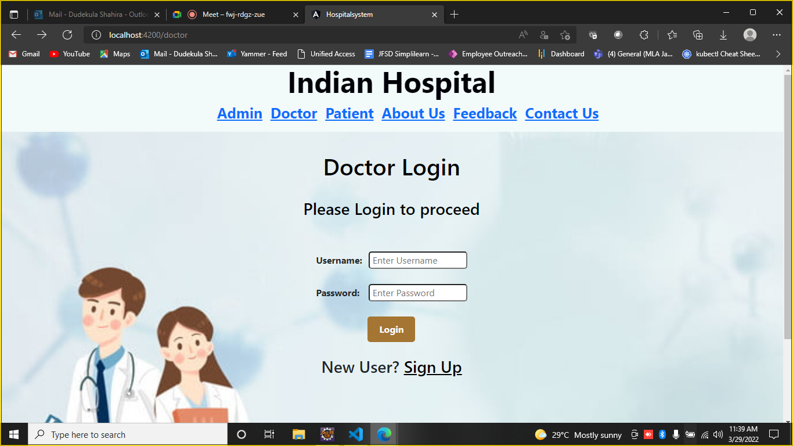
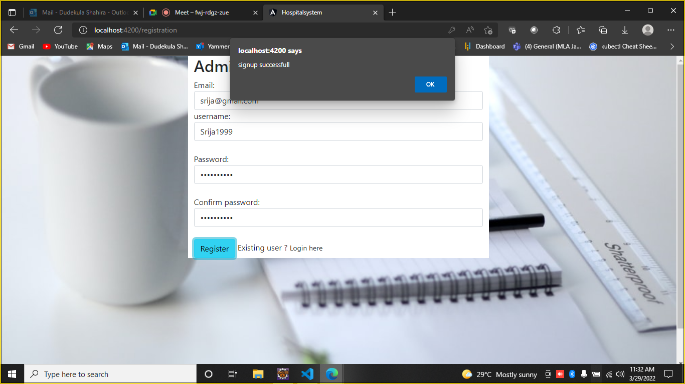
Admin Signup/Login

Slide 14
Doctor module
Doctor can view patient details,name, address, appointment date etc, perform actions delete patient details
A doctor can be managed following this:
Doctor can Login and SignUp
Doctor can see the Appointment List and Discharge List
Doctor can DELETE the Appointment

Slide 15
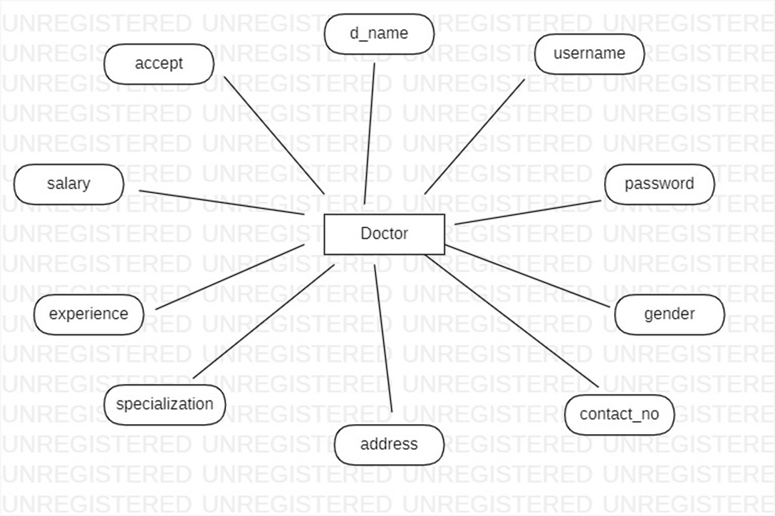
DOCTOR ER-DIAGRAM
d_id

Slide 16
Doctor Sign up/login table
Column Name | Data Type | Length | Nulls
d_ID | Int |  | -
Accept | Varchar | 255 | Yes
Address | Varchar | 255 | Yes
Contact-no | Varchar | 255 | Yes
d-name | Varchar | 255 | Yes
Experiance | Varchar | 255 | Yes
gender | Varchar | 255 | Yes
Password | varchar | 255 | Yes
Salary | varchar | 255 | Yes
Specialization | varchar | 255 | Yes
Column Name | Data Type | Length | Nulls
username | Varchar | 255 | -
password | Varchar | 255 | -

Slide 17
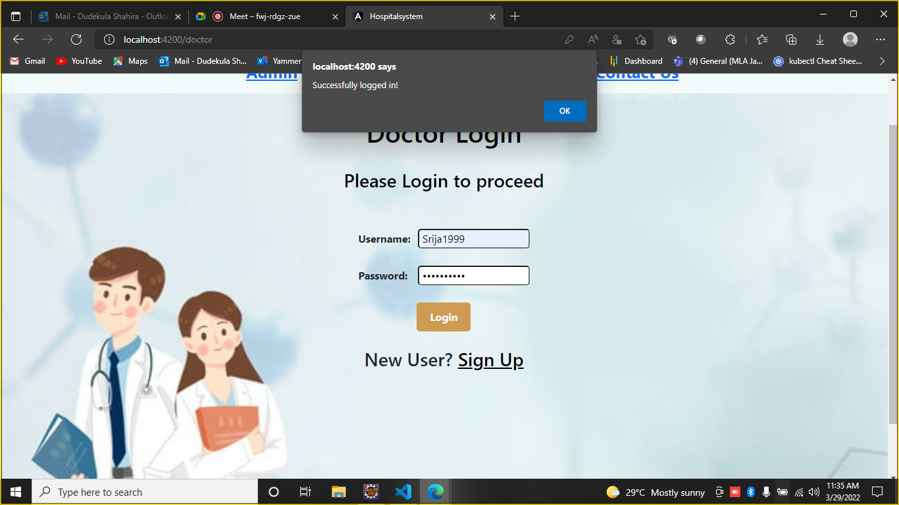
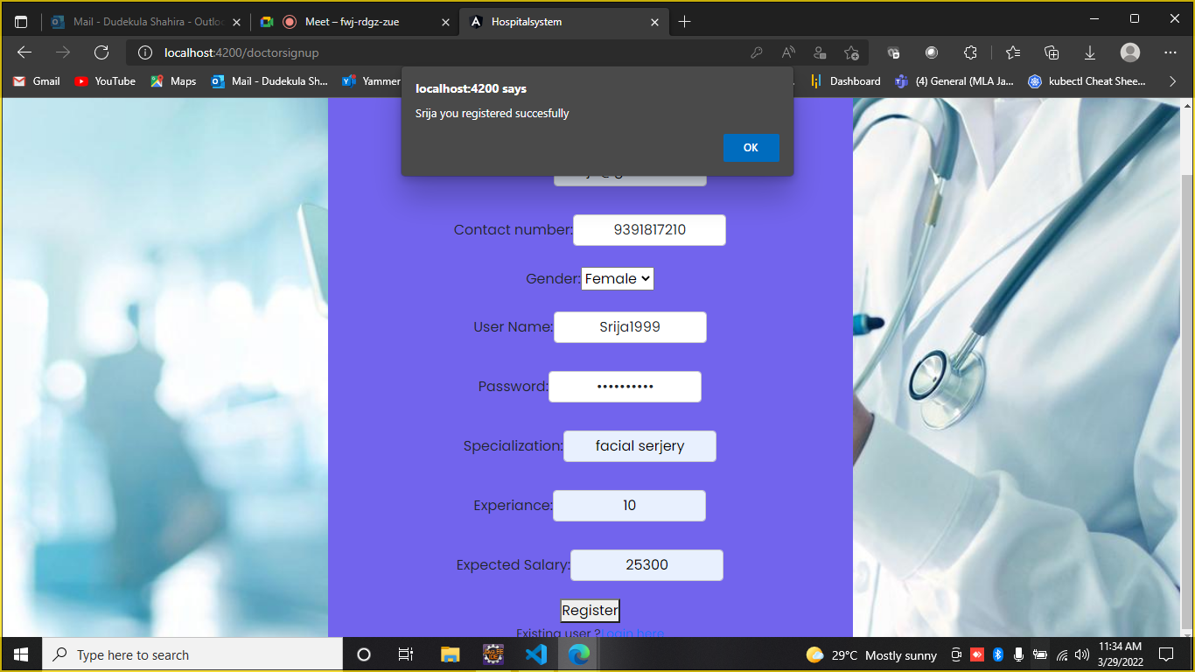
Doctor login/signup

Slide 18
Patient module
Patient:
Patient can Login and SignUp
Patient can see the Doctor List
Patient can Register the Appointment.
Patient can fill the form of Discharge Appointment
Patient can give the Feedback to the Doctor

Slide 19
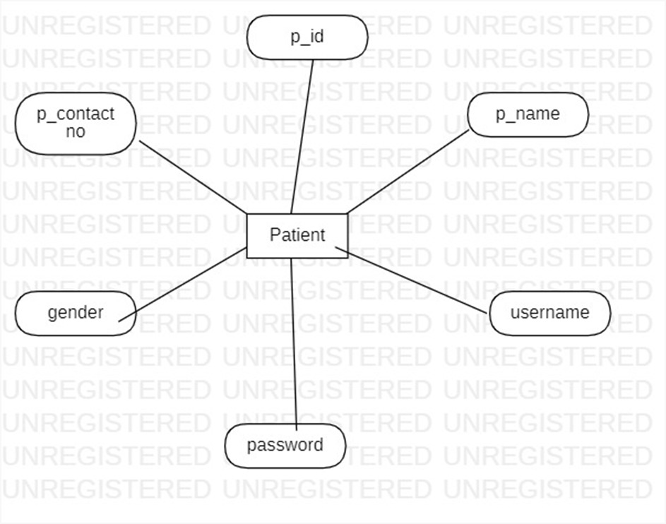
PATIENT ER-DIAGRAM

Slide 20
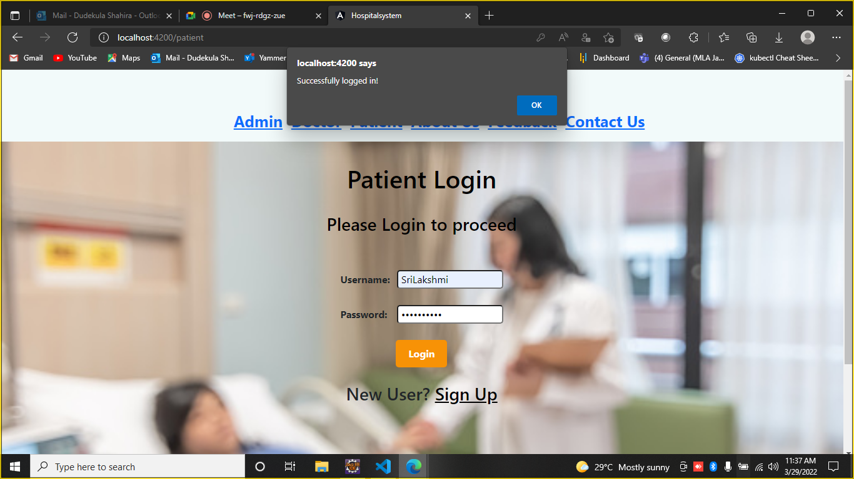
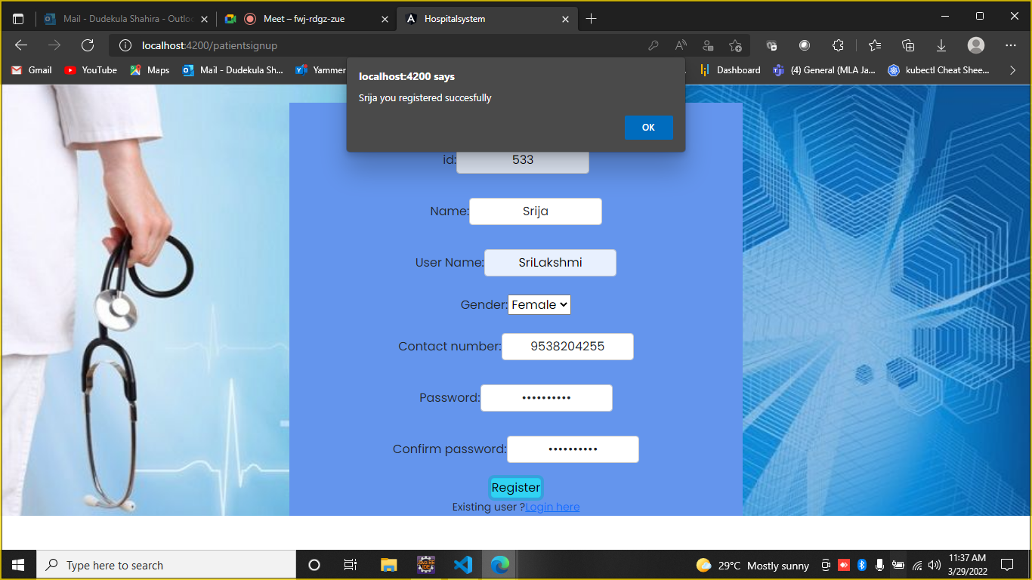
Patient login/Signup

Slide 21
FEEDBACK MODULE
Patient can Submit feed back form of doctors and these feedback form can only view by admin

Slide 22
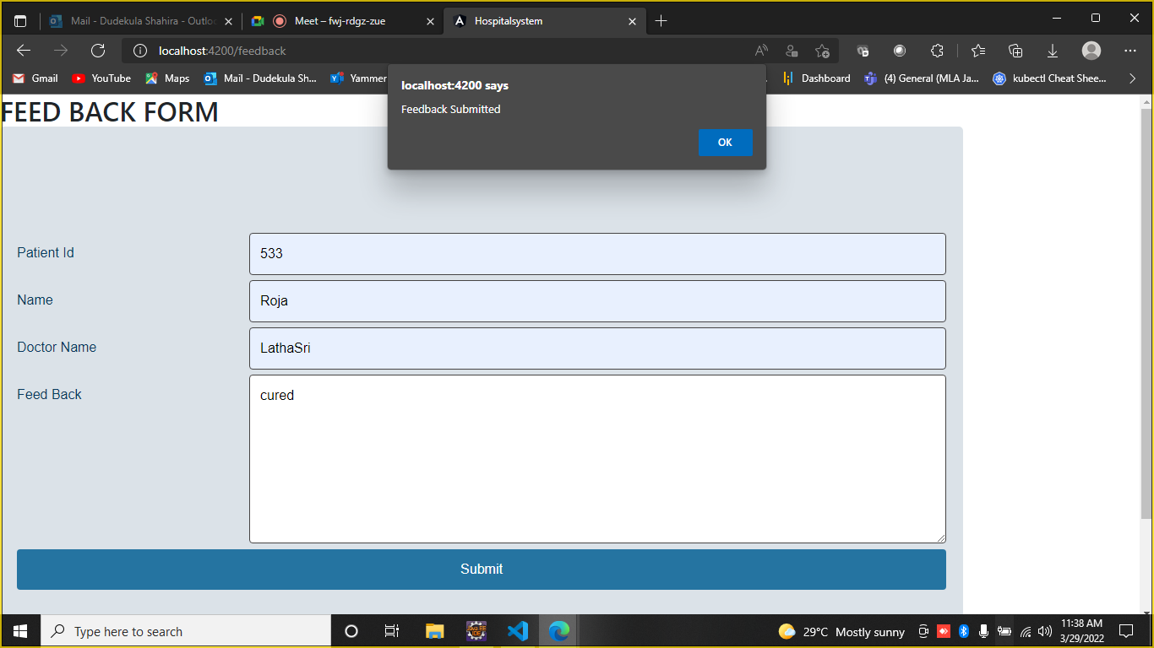
Feedback Form

Slide 23
Advantages :
Nowadays, due to pandemic people are prefering online clinical treatment of health and now a days everything is digitalized.
Patient self-service.
Avoid errors and track every single details.
Cost efficiency and less time consumption.
We can maintain the digital medical records.
Establish our hospital to be Technical advanced.

Slide 24
Disadvantages:
One of the greatest disadvantages of the hospital management system is generally related to security. It is considered to be a matter of concern in case you go online without enough protection which can create some big problems related to security

Slide 25
Features available
Admin
Login
Create Admin Account
Doctor List
Patient List
Feedback
Doctor
Signup
Login
Appointment list
Discharged list
patient
Signup
Login
Doctor details
Discharge form
Appointment registration

Slide 26
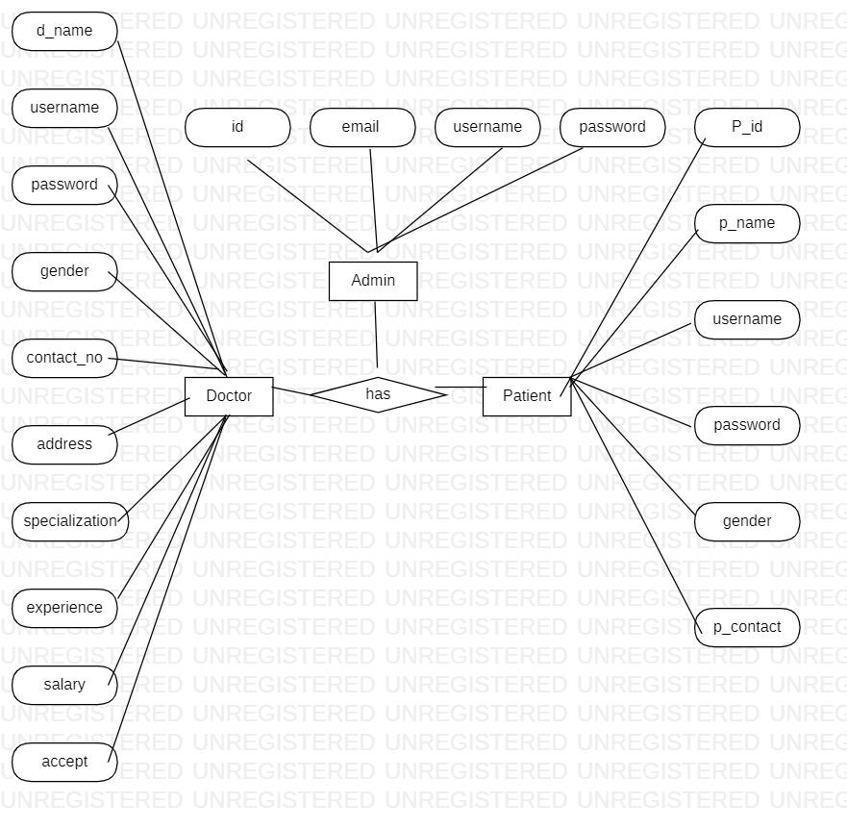
App flow
d_id

Slide 27
Conclusion
Hospital management systems allows us the ability to optimize and digitize all the processes within the institution.
It will help to improve customer service, reduce process costs, streamline the search of medical records, bills, patients, doctors, etc.
Hospital Management System will contributed enormously to better health and influenced the lives and well-being of billions of humans.

Slide 28

Thank You

